Slide 1
Compton Scattering
Alejandro Legarda

Slide 2
Purpose
To show how the energy of Compton-scattered photons depends on the angle of scattering. Specifically, we tested the validity of the Compton equation for Cs-137, using an aluminum scatterer.

Slide 3
Method
Our setup consisted of a pair of radioactive Caesium-137 sources housed in a radio-insulating box with a narrow opening. These produce gamma rays at 662 keV, which come out the opening as a collimated beam. The radioactive decay is
directed at a cylindrical aluminum rod that scatters incoming photons at random angles.

Slide 4
A photomultiplier tube is mounted on a circular rail, allowing us to observe photons at different scattering angles. Photon energy is quantified using software, allowing us to record the relationship between scattering angle and photon energy.

Slide 5
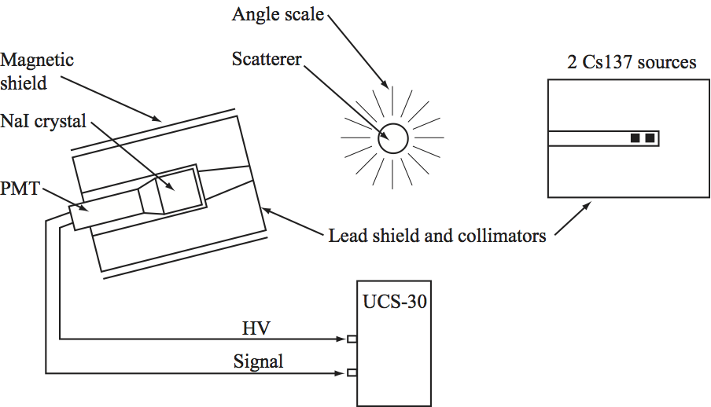
Apparatus

Slide 6
Error Analysis
Random error in angle
Largest source of random error is in determining peak centroids
Systematic error in energy (centroids) from PMT needs to be calibrated for
Sensitive measurement means calibration needs to be done more than once
Use average of calibrations across data

Slide 7
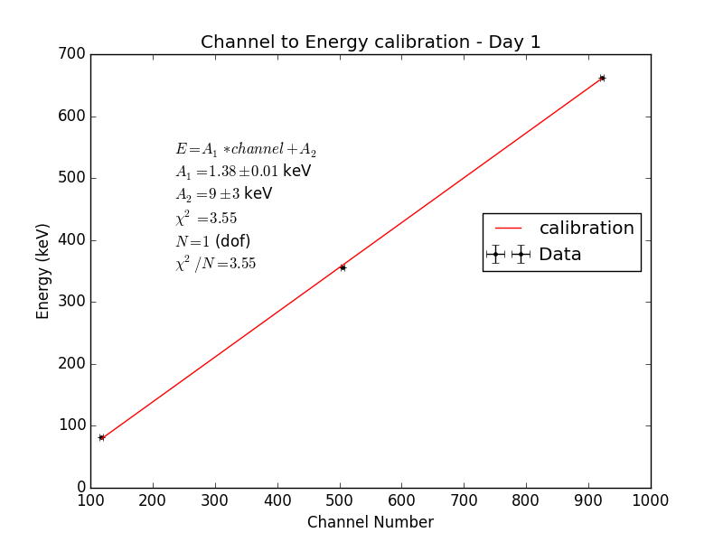

Slide 8
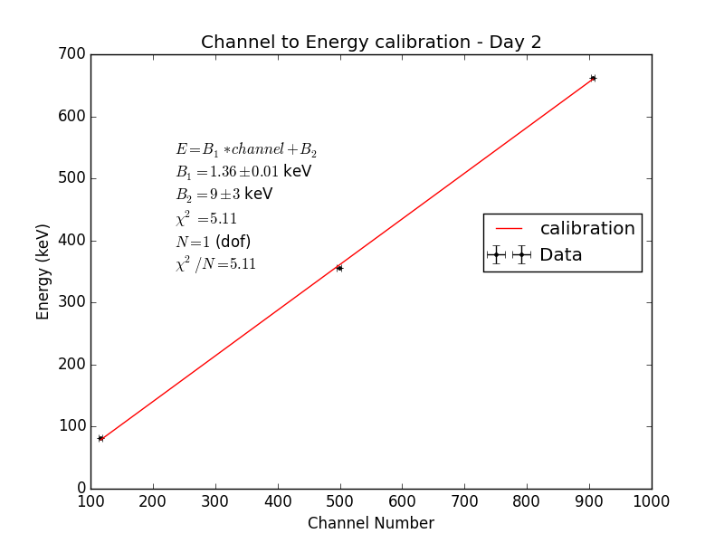

Slide 9
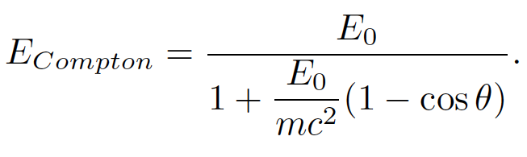

Slide 10
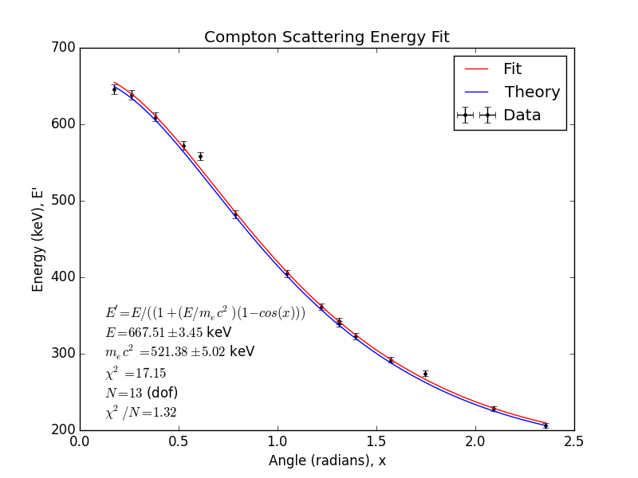

Slide 11
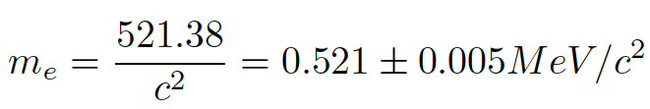

Result
This is close, but not in good agreement with the literature value given below.

Slide 12
Conclusion
Our data and fits show the Compton relation well
Our biggest source of uncertainty is the systematic lower than expected energy measurements, as can be seen in our final plot
This could be simply due to energy loss somewhere in the apparatus before the quantification of photon energy is done.

Slide 13
References
[1] University of Chicago Department of Physics. \Compton Scattering"
https://wiki.uchicago.edu/display/P211manuals/Compton+Scattering. (Accessed 4/20/16)
[2] Taylor, John. An Introduction to Error Analysis. Sausalito: University Science Books, 1997.

